Slide 1

RELATIONSHIP BETWEEN STUDY HOURS AND ACADEMIC PERFORMANCE BY USING DATA VISUALIZATION
TEAM NAME: FUTURE TALENTS
PRESENTED BY
S. Babyshalini
S. Ishwarya
S. Keerthana
S. Sheela
R. Sineka
A. Swathi

Slide 2
INTRODUCTION :
* Identify the data sources you will be using. This could include attendance records, results.
* Teach students about differ types of visualization.
* Considering factors like attendance trends over time, popular activities between different variables.

Slide 3
PROBLEM STATEMENT :
*Clearly define the specific problem or challenge releated to student activities that requires data visualization for analysis and understanding.
* Distribution of resources among activities or the need to identify trends and preferences among students.
* Identify the Intended audience for the data visualization. Whether, its school administrators, teachers, student leaders, or other stakeholders involved in decision – making related to student activities.

Slide 4
SOLUTION :
* choose appropriate visualization types based on the objectives of the analysis.
* Identify key metrical such as attendance rates, participation levels, popularity of activities and demographic trends.
* Apply predictive modeling techniques, it applicable, to forecast future trends in student activities based on the historical data.

Slide 5
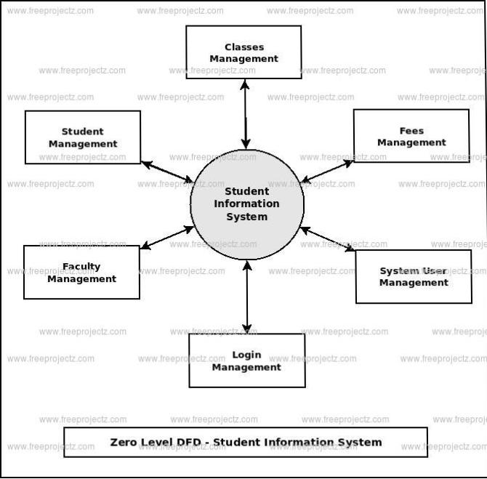
FLOWCHART :

Slide 6
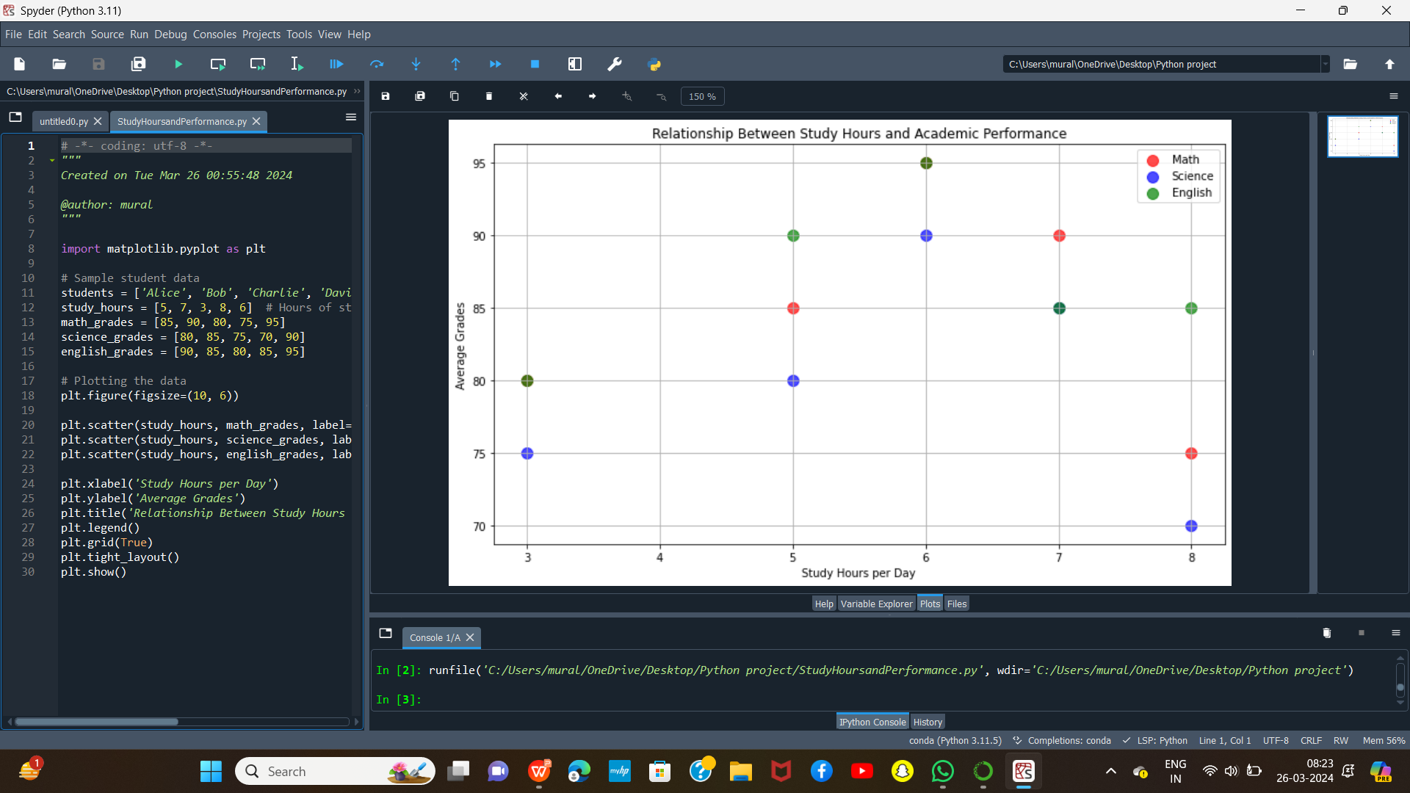
PIE CHART :

Slide 7
CONCLUSION :
* Data visualization enables deep dive into student activities, providing insights into participation trends, preferences and areas for improvement.
* Visually, representing data, stakeholders can make informed decisions regarding resource, activity planning and students engagement initiatives.
* Understanding student activity data enables schools to trailer interventions and initiatives to better meet the diverse needs to interests of students.

